Slide 1
Digital AI Assistant
Trien Dau - Presenter
Haru Chu

Slide 2
Project Members:
Project Advisor:
Trien Dau: M13292604 - dautx@mail.uc.edu
Haru Chu: M13741094 - chuqc@mail.uc.edu
TBD

Slide 3
Project Abstract:
Our project aims to develop a cutting-edge Digital AI Assistant, harnessing the power of ChatGPT API, text-to-speech, and speech-to-text technologies. This innovative assistant will enable seamless human-machine interactions, offering natural language understanding and generation, as well as facilitating voice-based communication. By combining the capabilities of ChatGPT with advanced audio processing, our solution will empower users with hands-free, context-aware assistance for various applications, from virtual companions to productivity tools. This project represents a significant step forward in the evolution of AI-driven digital assistants, providing a bridge between the digital and physical realms.

Slide 4
User Stories:
As a busy professional, I want a voice assistant with chatGPT capabilities, so that I can easily draft emails, reports, and messages by simply speaking, saving me valuable time and improving my productivity.
As a student, I want a voice assistant like Siri with chatGPT capabilities, so that I can ask questions, get explanations, and receive assistance with my homework and studies, helping me excel in my academic pursuits.
As a tech-savvy individual, I want a voice assistant that integrates chatGPT, so that I can have more natural and informative conversations with my device, making my interactions with technology more enjoyable and efficient.

Slide 5
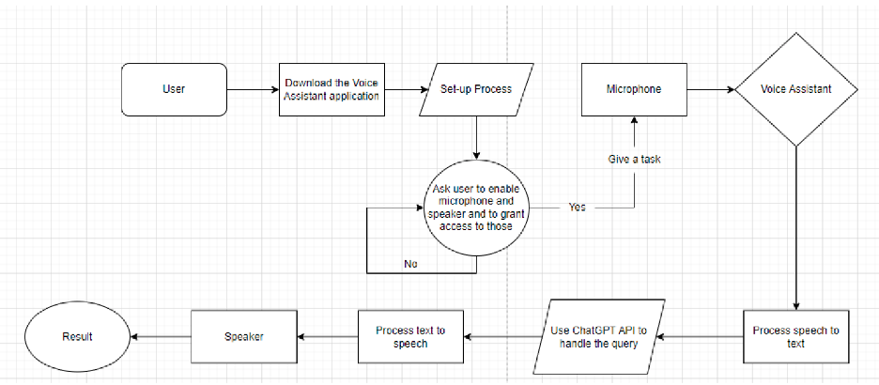
Design Diagram:

Slide 6
Project Constraints:
Economic Constraints: One of the primary economic constraints revolves around the cost of development and maintenance. Integrating advanced NLP and voice recognition technologies and continuous improvements in AI models can be financially demanding.
Ethical Constraints: Ethical considerations are paramount when developing AI-driven voice assistants. The assistant must prioritize user privacy and data security, safeguarding against potential misuse of personal information.
Legal Constraints: Legal considerations encompass a wide range of issues, from intellectual property rights associated with voice recognition and NLP technologies to compliance with data protection and privacy regulations (e.g., GDPR or CCPA). Ensuring that the project adheres to these regulations is critical to avoid legal repercussions.
Diversity and Cultural Impact: Building a virtual voice assistant requires sensitivity to diverse cultural backgrounds and languages. Ensuring the technology is culturally inclusive and does not inadvertently favor one group over another is a complex challenge.

Slide 7
Review of Project Progress:
Studied the ChatGPT API, Text-to-speech, and Speech-to-text.
Discussed and agreed on the platform and programming languages to be used for this project.
Planned out project outline to make sure everything will be completed on time.
Brainstormed and designed the first draft for the application.
Next step: Start building first prototype for the application.

Slide 8
Expected Accomplishments:
Build the functional prototype of the application.
Successfully pull and implement the ChapGPT API to be used in the application.
Study which APIs to use for Text-to-speech and Speech-to-text.

Slide 9
Division of Work:
Trien Dau:
Brainstorm and design the layout/User Interface of the application
Build application prototype
Specify what accessibilities will be needed from the user to ensure that the program runs smoothly
Verify that the program meets all requirements
Test run app to look out for any potential bugs/issues
Haru Chu:
Research which API will be needed for Speech-To-Text
Investigate which API will be used for Text-To-Speech
Look into how to use ChatGPT API to handle any queries from the user
Build the actual Voice Assistant with all of the mentioned functionalities
Upload the application so that other people can access and download

Slide 10
Expected Demo at Expo:
A working Digital AI Assistant with all of the mentioned functionalities, which can listen to users’ prompts and giving back results based on those inputs.
It should be able to answer most questions from the users and provide meaningful outputs.

